Slide 1


Contribute to SFML: A C++ Multimedia Library
Interested in open-source multimedia development? SFML is a simple, fast library written in C++. It supports graphics, audio, and networking.
This presentation will introduce you to the library and how to contribute. Learn about the project, its features, and how to get involved.
by Prince Patel

Slide 2
SFML: Overview of Features
Cross-Platform Window Management
2D Graphics Rendering
Audio and Music Playback
The library includes robust 2D rendering capabilities. It allows developers to draw shapes, images, and text.
SFML offers classes for handling audio playback. Developers can play sound effects and music with minimal code.
SFML provides an easy API for creating and managing windows. It supports multiple platforms, including Windows, Linux, and macOS.

Slide 3
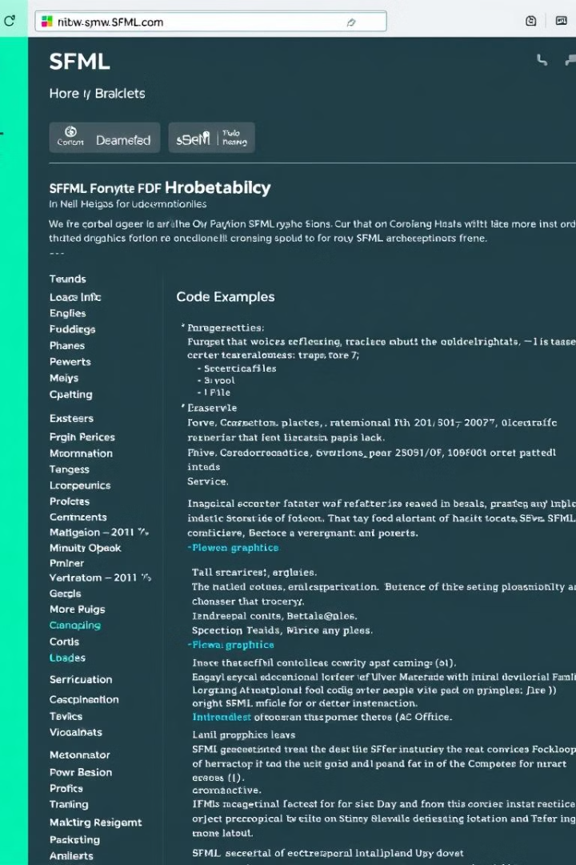



Why Choose SFML?
Easy to Use API
Lightweight and Modular
SFML's API is designed to be intuitive and straightforward. It allows developers to quickly prototype multimedia applications.
The library is lightweight, with a modular design. Developers can select the modules they need, reducing the application size.
Well-Documented API
SFML offers comprehensive documentation. It makes learning and using the library easier for both beginners and experts.

Slide 4
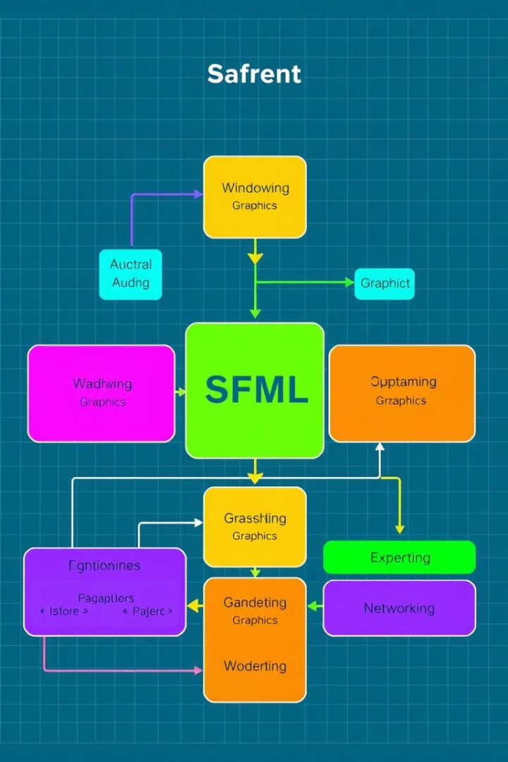




SFML Architecture: Key Components
Graphics System
SFML uses OpenGL for rendering graphics. This provides efficient and hardware-accelerated performance.
Windowing
The sf::RenderWindow class manages window creation. It also handles events, like keyboard and mouse input.
Audio
sf::Sound and sf::Music handle audio playback. These classes support various audio formats and features.
Networking
sf::TcpSocket and sf::UdpSocket enable network communication. This allows for multiplayer games and network applications.

Slide 5
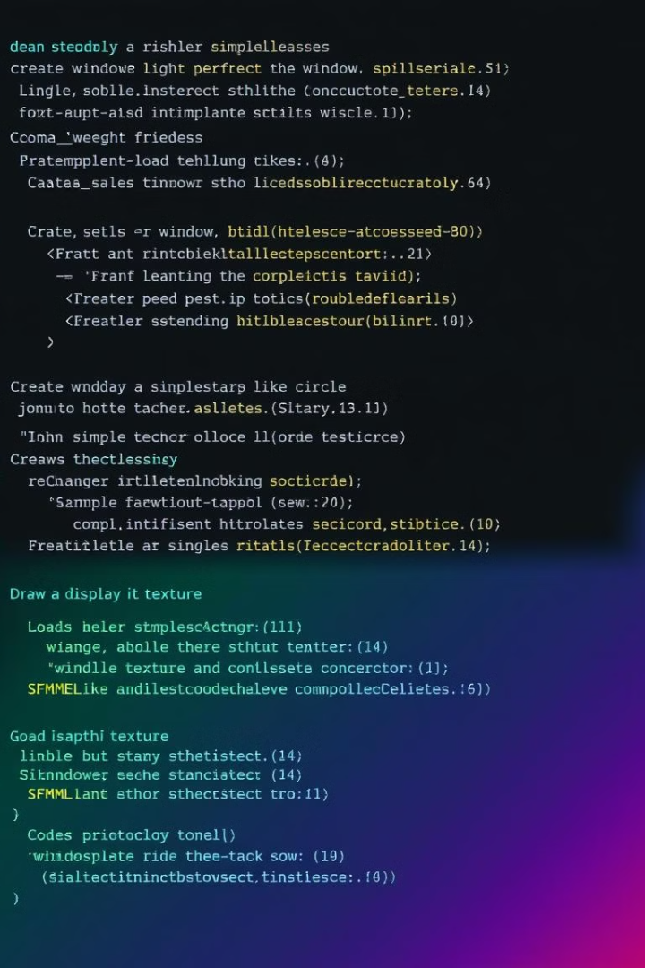
Important SFML Classes
sf::RenderWindow
Manages windows and rendering contexts. Essential for creating and displaying graphics.
sf::Texture & sf::Sprite
Handles image loading and drawing. Used for creating visual elements in the application.
sf::SoundBuffer & sf::Sound
For loading and playing audio. Supports various audio formats for flexibility.
sf::Event
Captures keyboard and mouse events. Allows users to interact with the application.

Slide 6
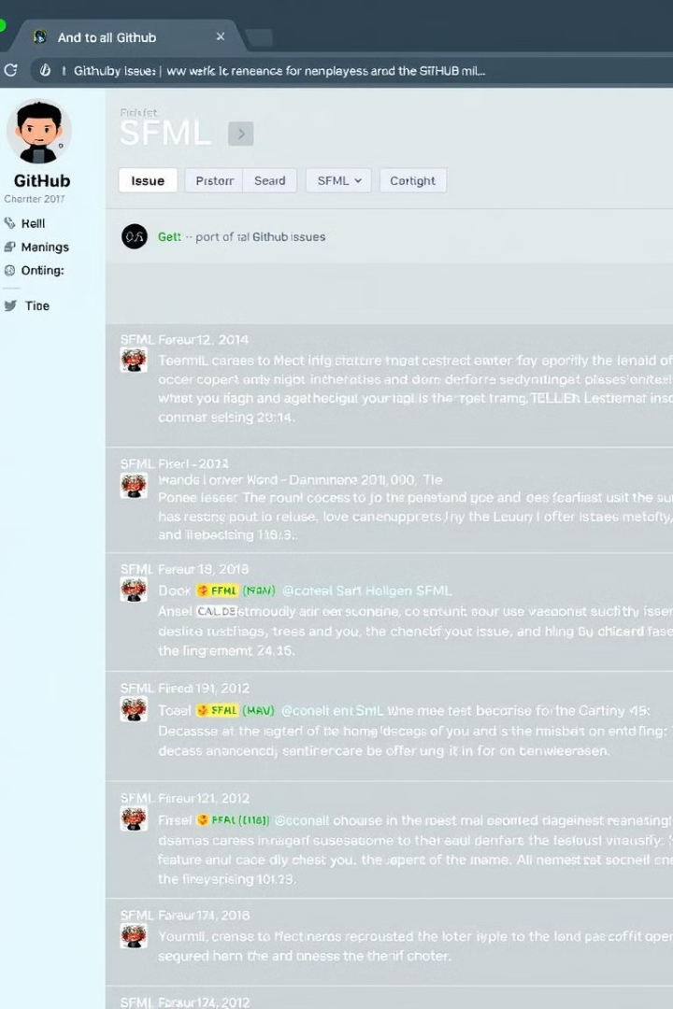



Contribution Opportunities
Improve Documentation
Clarify existing documentation with examples. Add new documentation for advanced features.
Enhance Sample Code
Create new sample projects demonstrating library usage. Improve existing examples with better practices.
Solve Minor Bugs
Address reported issues in the GitHub repository. Test and provide fixes for identified problems.

Slide 7
Trade-Offs and Challenges
Pros
Cons
Simple API
Limited 3D support
Cross-platform
OpenGL dependency
Lightweight
SFML has limitations in 3D rendering and relies on OpenGL.
SFML's benefits include ease of use and wide compatibility.

Slide 8

Conclusion: Get Involved with SFML
SFML is a versatile multimedia library for C++ developers. It offers a wide range of features and is easy to use.
Explore the GitHub repository and start contributing. Your contributions can help improve the library for everyone.

